Slide 1
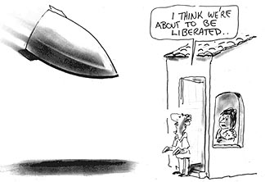
Winning the peace:
Western Intervention and The Arab World
The case of Syria and regional
geopolitical implications
By Dr. Marat Terterov
NORAVANK Foundation,
Yerevan

Slide 2
PART ONE
THE BROAD CONTEXT OF FOREIGN INTERVENTION
A. INTERVENTION AND NON-INTERVENTION DO NOT HAVE A GOOD RECORD
Humanitarian Intervention and
Responsibility to Protect
vs.
State Sovereignty
and
Norm of Non-Intervention
Intervention to prevent the perpetration of mass atrocities and spillover effects?
Refrain from intervening to avoid greater domestic and regional instability?
Arab-Israeli conflict
(from 1948…)
Korean War (1950-1953)
Afghanistan
(2001-today)
Kosovo
(1999)
Congo
(1960-1966 and today)
Rwandan Genocide (1994)
Libya
(2011)
Somalia
(since 1991)
Iraq
(1991-1992 and 2003-2011)
Bosnia-Herzegovina (1992-1995)

Slide 3
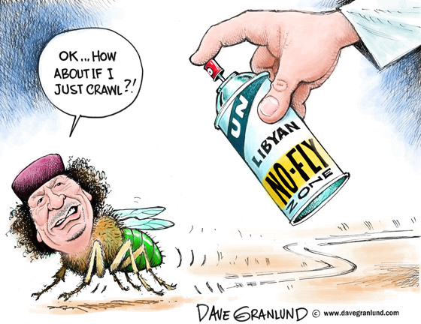
THE CASE OF LIBYA
An innovative example of intervention?
First time the UN SC gives reference to the responsibility to protect and humanitarian intervention
Demands of regime change from Libyans
Backseat position of the US
BUT…
Consequences of intervention?
Int’l community long-term commitment?
Effects of foreign presence on nation-building?
Can Libya stand on its own legs?

Slide 4
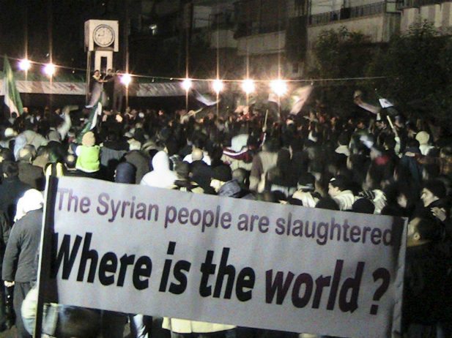
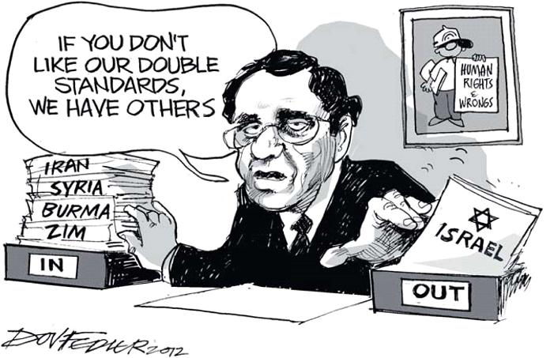
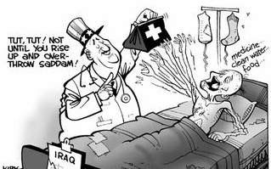
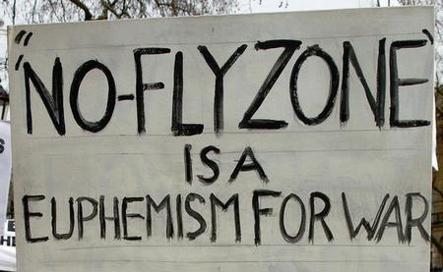
B. WHAT DRIVES THE DECISION TO INTERVENE?
Morality, foreign policy and national interests?
- Morality and hard-line national interests
- If it were morality, conflicts like the one between Israel and the Palestinian territories would be over
The international community and double-standards?
- Turning a blind eye on a certain category of domestic crises/acts
Do economic sanctions work?
Are they effective?
Do they depend on strategic/geopolitical interests?
“Interventions in Afghanistan and Iraq have eroded public support for military action.” (J.S. Nye, The Intervention Dilemma)

Slide 5
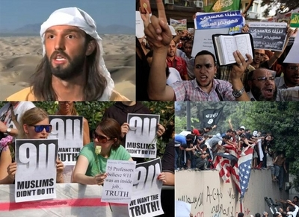
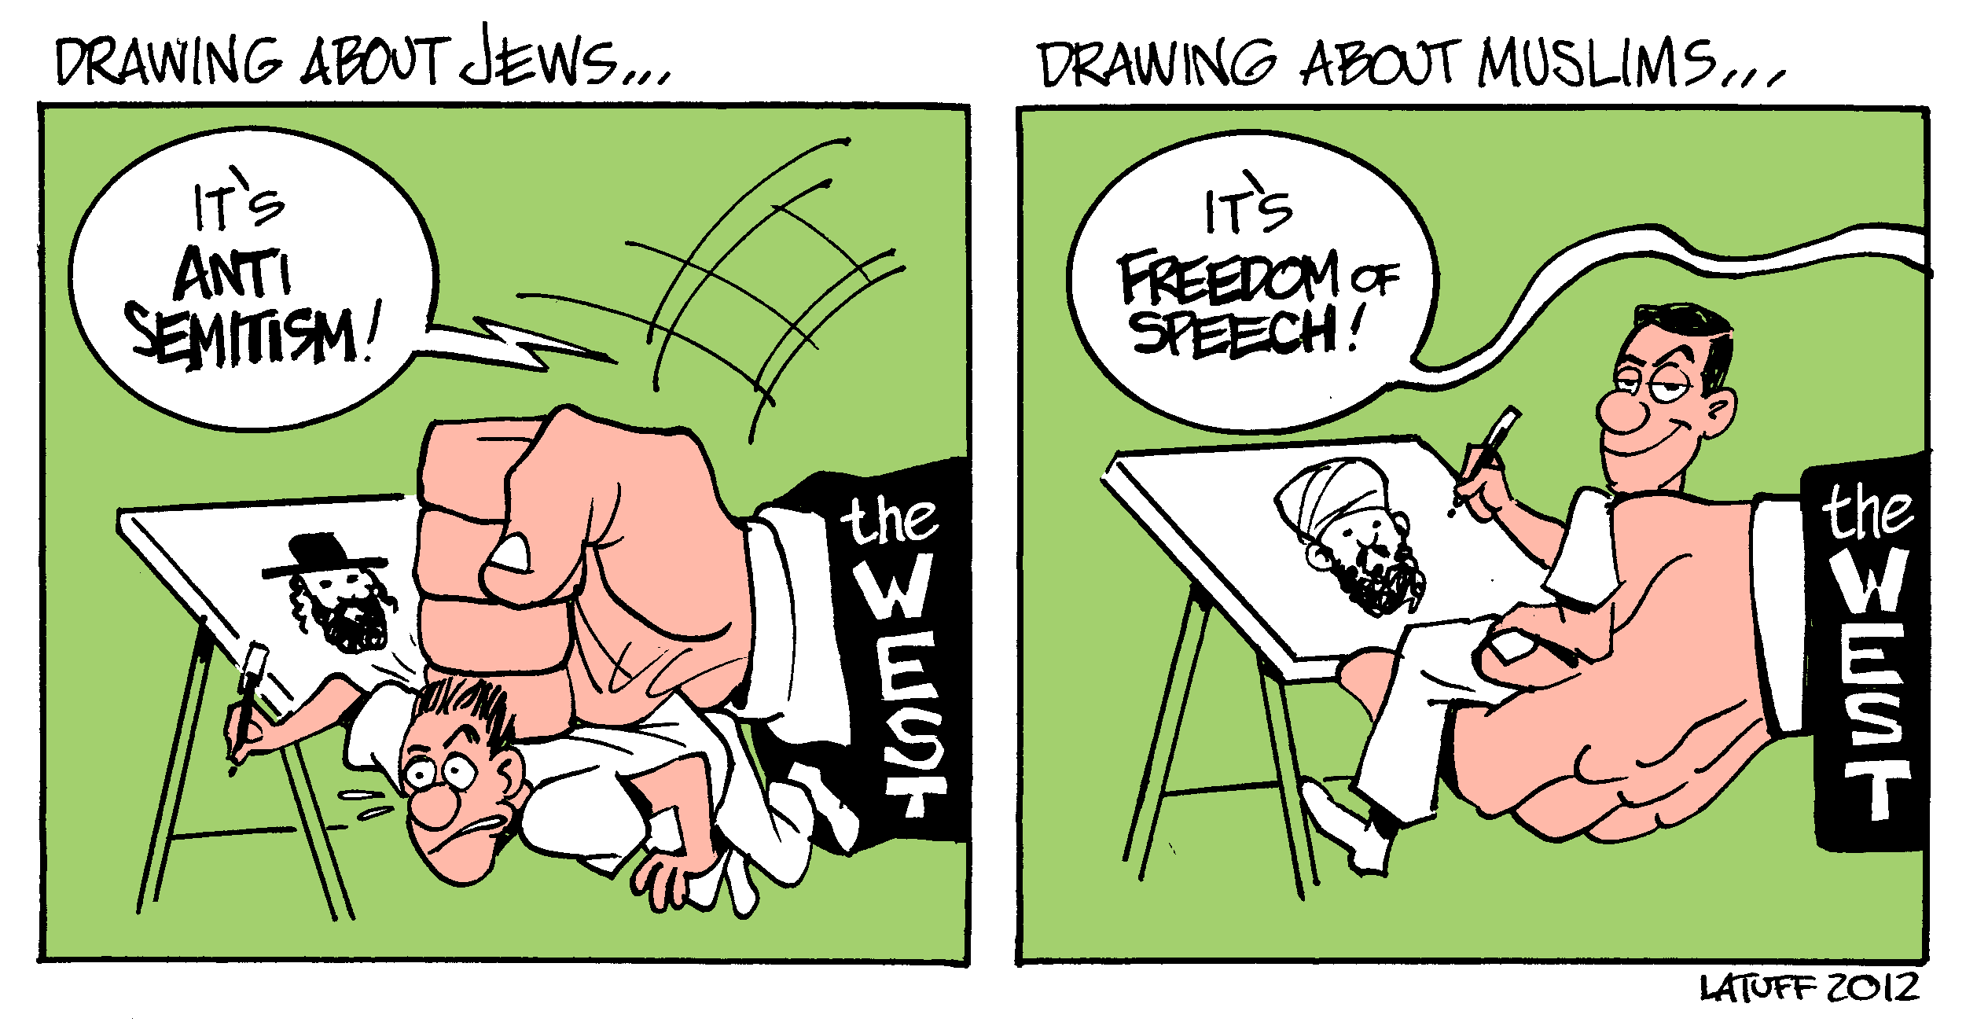
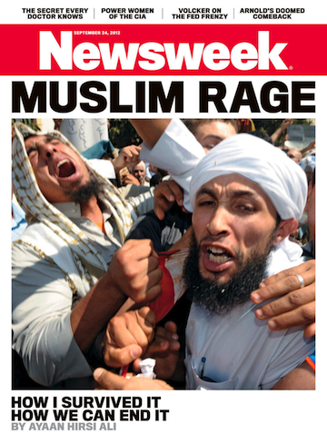
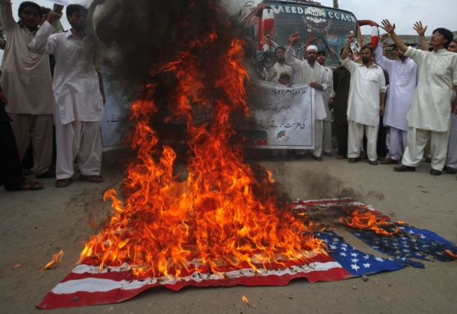
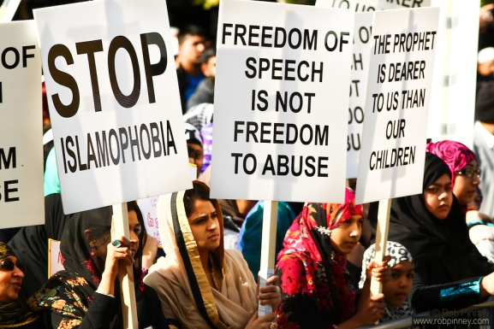
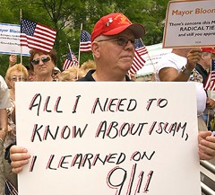
C. SENTIMENT IN THE MUSLIM WORLD DOES NOT FAVOUR WESTERN INTERVENTION
Are we witnessing a rise in Islamophobia in the West and in Westernphobia in the Arab World?
The “Innocence of Muslims”, deliberate provocation or product of “loose canons”?
Has the movie been used by extremists to justify terrorist acts?
Was the assassination of Ambassador Stevens and three US official a direct consequence of Islamophobia?
Islamophobia has led to Westernphobia, which in turn has been instrumentalize by extremists, Islamic parties, Salafists and mainstream Islamists to depict the West as a colonizing power and not as an agent of democracy

Slide 6
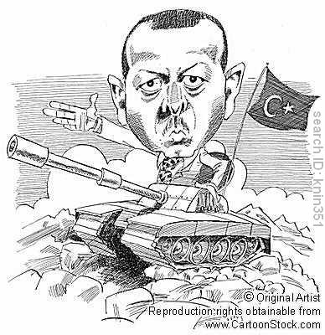
Seen by its neighbours suspiciously
Have the consequences of the Arab Spring changed Ankara’s role in the region?
Have the consequences of the Arab Spring changed Ankara’s role in the region?
Neo-Ottomanism?
COULD TURKEY BE THE BRIDGE BETWEEN EAST AND WEST?

Slide 7
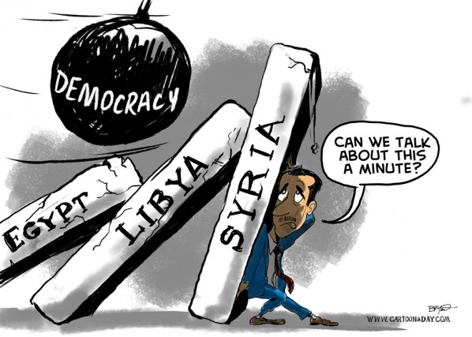
PART TWO
THE CASE OF SYRIA: EVALUATING THE BALANCE OF
CONSEQUENCES OF INTERVENTION AND REGIME
CHANGE
A. WINNING THE PEACE AND NOT THE WAR: CAN WE CONTROL THE CONSEQUENCES OF INTERVENTION?
What are the chances of an intervention in Syria?
Why Syria is not Libya
The position of Turkey
The UN SC can’t reach unanimity
NATO, Turkey and Article 5
Damascus is turning a blind eye on Kurds in the northeast: provocation to Ankara?
How will the ‘solution’ of the Syrian conflict impact on Iran?
Regime change, regional instability and geopolitical interests

Slide 8
B. WHAT COMES AFTER AL-ASSAD?
Outbreak of sectarian violence, particularly against the Alawites and Christians
Safe haven for Iraqi insurgents and Kurds
Military operation or peacekeeping mission in the context of a “deadly chemical environment”
What will the end of the Al-Assad regime mean for Iran and Lebanon?
Great concerns for the stability of the wider region:
Will Iran become more aggressive, having lost one of the few allies in the region?
How will the stability of neighbouring states be affected (Jordan, Iraq, Lebanon)
What effects will the end of the Al-Assad regime have on Israel?

Slide 9
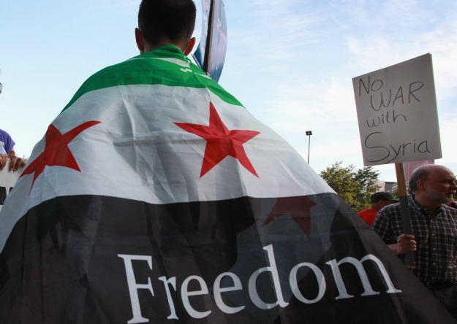
THE END…
THANK YOU FOR YOUR ATTENTION!
ANY QUESTIONS?

