Slide 1

CONFERENCE ANNUELLE « VOISINAGES »:
« LES MULTIPLES CRISES DU VOISINAGE MENACENT-ELLES LE PROJET EUROPÉEN JUSQUE DANS SES VALEURS FONDAMENTALES ? »
L’AJUSTEMENT DIFFICILE DE LA POSITION DE L’UE FACE AU RECOURS À LA FORCE EN VIOLATION DU DROIT DES GENS. COMMENT CONTRER LES AGRESSIONS RUSSES EN UKRAINE ET DANS LE CAUCASE ?
Mr. George Vlad Niculescu,
Head of Research, European Geopolitical Forum,
http://www.gpf-europe.com

Slide 2
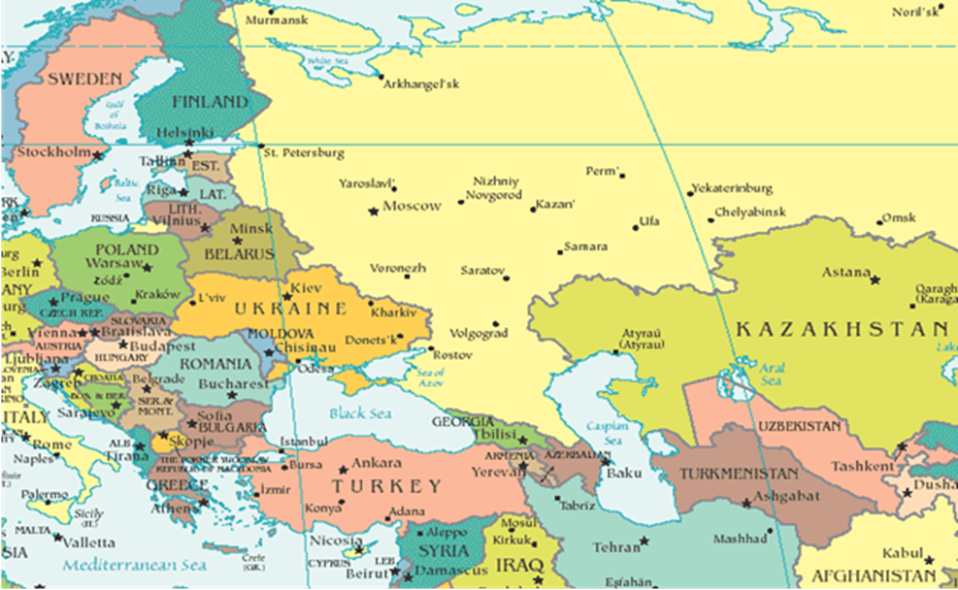
“In today's world there is no way we can isolate ourselves from the outer world. We cannot “fence out” our problems. Europe needs to engage, inside our region and beyond. Engagement is our key, our core interest.” HR Federica Mogherini @ EU Global Strategy Conference organized by EUISS and Real Institute Elcano, Barcelona, on 26/11/2015

Slide 3
OVERVIEW
How and Why Did the EU Get into the Current Confrontation with Russia?
Four Empirical Security Scenarios for Western Confrontation with Russia
What Does Russia Expect from the EU?
Recommendations for EU’s Policies in the Eastern Neighbourhood

Slide 4
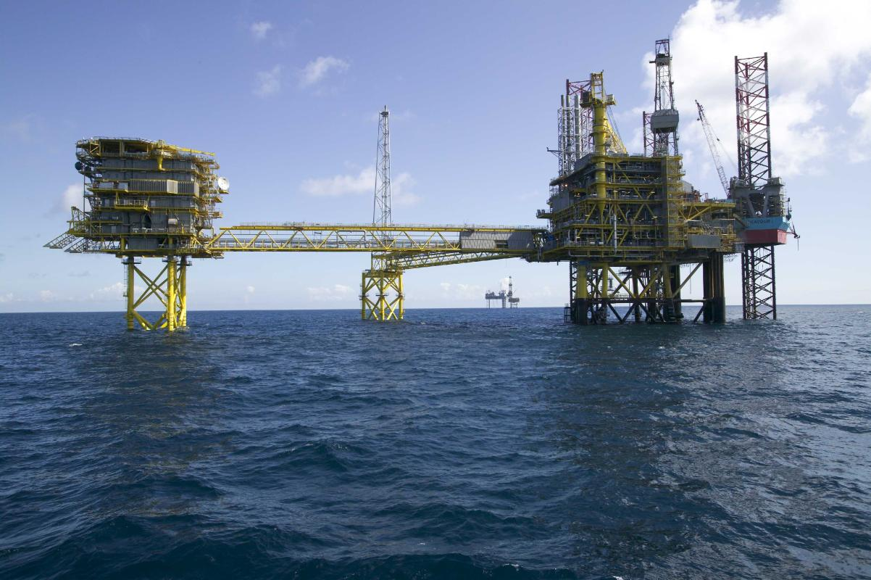
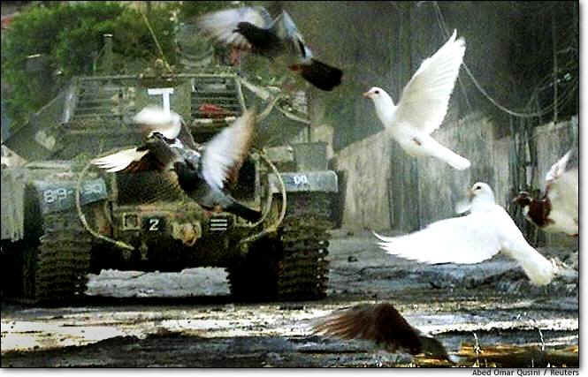
How and Why Did the EU Get into Confrontation with Russia?
V. Putin (2005): “Above all, we should acknowledge that the collapse of the Soviet Union was a major geopolitical disaster of the century. As for the Russian nation, it became a genuine drama. Tens of millions of our co-citizens and compatriots found themselves outside Russian territory.”
Two rounds of NATO enlargement, Big Bang EU enlargement, the Rose and Orange Revolutions;
Eastern Partnership perceived by the Russians as a geopolitical process;
Major political, economic, ideological, and security divergences feeding a geopolitical confrontation.

Slide 5
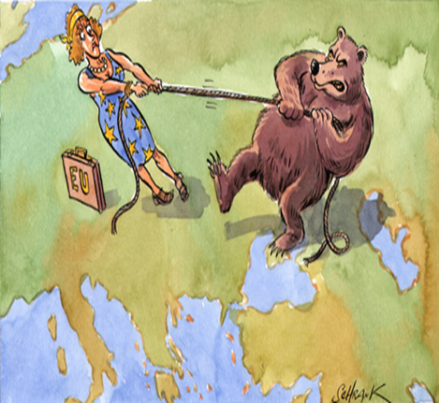
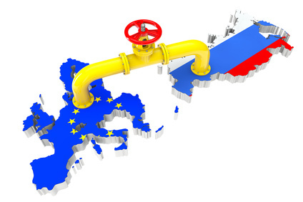
Four Empirical Scenarios for the Confrontation with Russia
What should be EU’s priority in the contested Eastern Neighbourhood? A compromise with Moscow on how to fix the broken security order, and roll back military intrusions in Ukraine and in Georgia? Or to defend shared values, and to annihilate the Russian power and influence in the region?
  1. Buffer Zone – best-case scenario.
  2. Western Decline.
  3. The Intermarium Alliance.
  4. Regional Chaos.

Slide 6
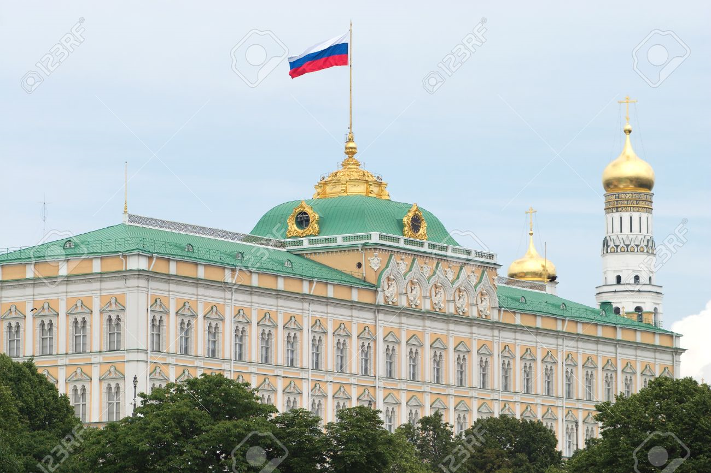
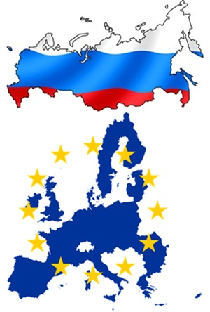
What Does Russia Expect from the EU?
“The geopolitical expansion of NATO, and the EU along with their refusal of a common European security and cooperation framework”, resulted “in a serious crisis in the relations between Russia and the Western States”.
“Russia’s long-term Euro-Atlantic policy is aimed at building a common space of peace, security and stability based on the principles of indivisible security, equal cooperation and mutual trust”.
“EU an important trade, economic and foreign policy partner for Russia.” [to] “establishing a common economic and humanitarian space from the Atlantic to the Pacific by harmonizing and aligning the interests of European and Eurasian integration processes.”

Slide 7
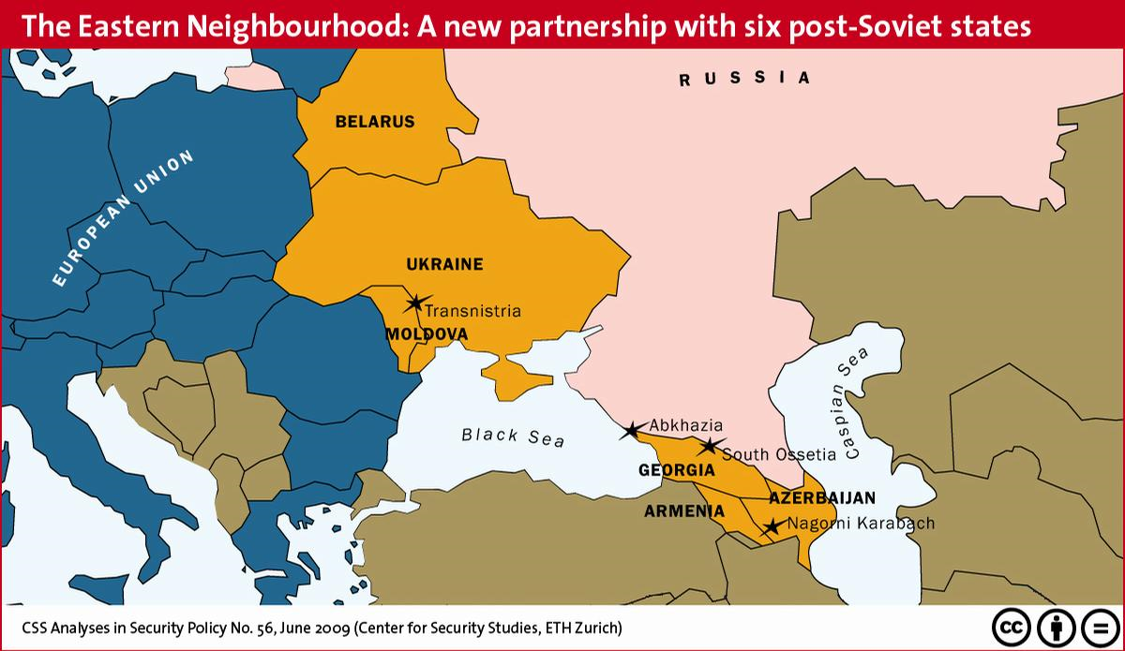
Recommendations for EU’s Policies in the Eastern Neighbourhood
  Being realistic about Russia and looking forwards, not backwards;
  Undertaking Geopolitical Responsibilities;
  Taking a More Pragmatic Approach towards Exporting Shared Values;
  Playing a leading role in searching viable solutions to the protracted conflicts;
  Revitalizing its involvement in strengthening regionalism.

Slide 8
DISCUSSION

