Slide 1

CONFERENCE ANNUELLE « VOISINAGES »:
«L’UE : quelles conditions pour des voisinages plus sûrs ?»
Bruxelles, 30 Janvier 2018
DE GRANDES NÉGOCIATIONS À ENGAGER DÈS QUE POSSIBLE:
RESTORE AND MODERNIZE THE NECESSARY DIALOGUE WITH RUSSIA
Are We About to Relapse into a “New Cold War” with Russia? How the EU Dialogue with Russia Could Further Advance European Security
Mr. George Vlad Niculescu,
Head of Research, European Geopolitical Forum,
http://www.gpf-europe.com

Slide 2
OVERVIEW
The EU Perspective
Russian Perspective
Assessing the Futures of EU’s Relations with Russia to the East
Conclusions and Recommendations

Slide 3
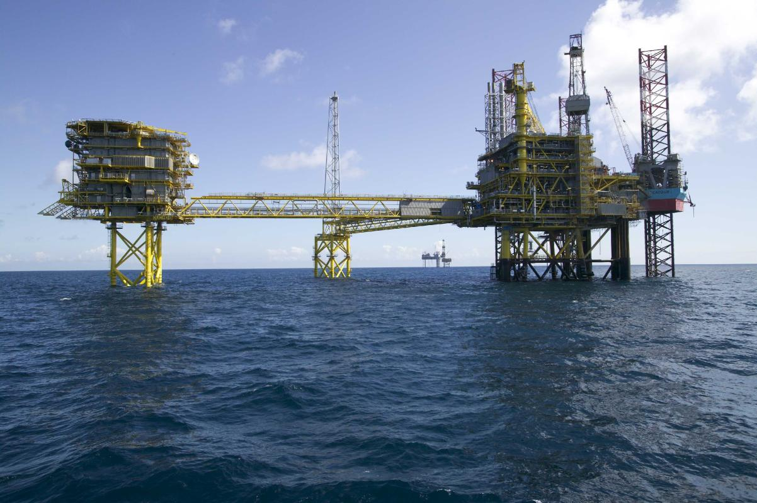
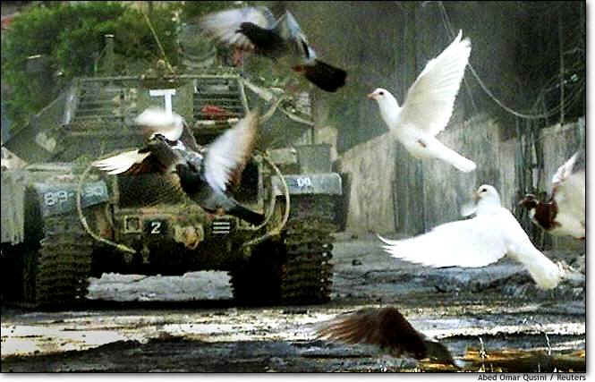
The EU Perspective
What should be EU’s priority in the contested Eastern Neighbourhood? A compromise with Moscow on how to fix the broken security order, and roll back military intrusions in Ukraine and in Georgia? Or to defend shared values, and to annihilate the Russian power and influence in the region?
Russia turned from a “strategic partner” into a “strategic challenge” for the EU (according to the EUGS);
Conditionality in restoring a comprehensive, cooperative dialogue with Russia upon progress in implementation of the Minsk 2 Agreements;
Restoring and modernizing EU’s dialogue with Russia is stuck with progress in Donbas conflict resolution, which, in the short term, neither party would be prepared to see through.

Slide 4
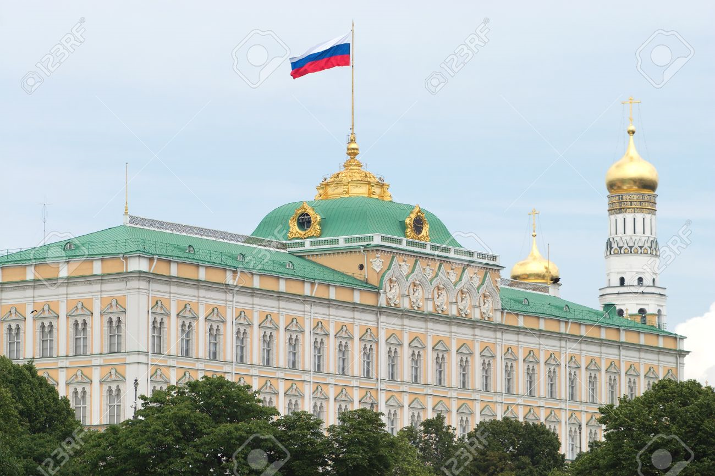
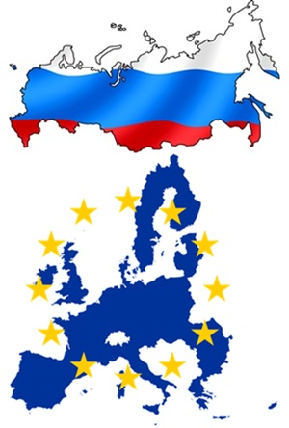
Russian Perspective
EU remained an important trade, economic and foreign policy partner for Russia. Its priorities in relations with the EU would aim at establishing a common economic and humanitarian space from the Atlantic to the Pacific by harmonizing and aligning the interests of European and Eurasian integration processes, with a view to preventing the emergence of dividing lines on the European continent.
Nadia Arbatova: the futility of reducing the different perspectives of Russia and the West to a common denominator. Instead, a re-focus on how to overcome the current status of relations, while restoring mutual trust, and on how to revise existing pan-European economic and security arrangements.
Would the EU be able to agree on pursuing a comprehensive and effective security dialogue with a “revisionist” Russia?

Slide 5
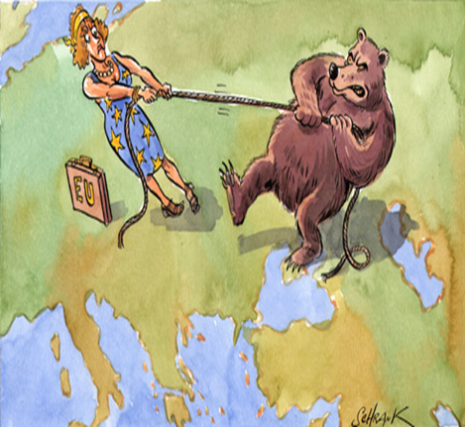
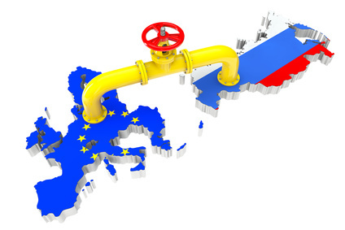
Assessing the Futures of EU’s Relations with Russia to the East
Research on “What security scenarios would most accurately outline the relations between the West and Russia in the geopolitical area between the Baltic Sea and the Wider Black Sea, in 2025-2030”? by means of the scenario planning method.
  1. The Buffer Zone: Power Sharing and Limited/Controlled Stand-off.
  2. Western Decline: European and Transatlantic Unity broken.
  3. An Inter-marium Alliance: New American Containment.
  4. Regional Chaos: Turning Confrontation into War.
Further research upon those hypothetical scenarios resulted in a list of drivers of change and external forces in the next decade (2018-2027), as well as in a scenario-matrix for relations between the West and Russia in Eastern Europe (Inter-marium).

Slide 6
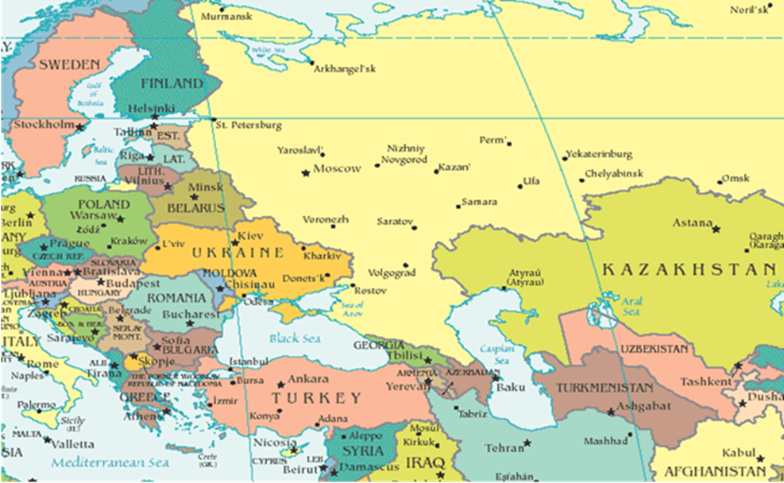

Slide 7
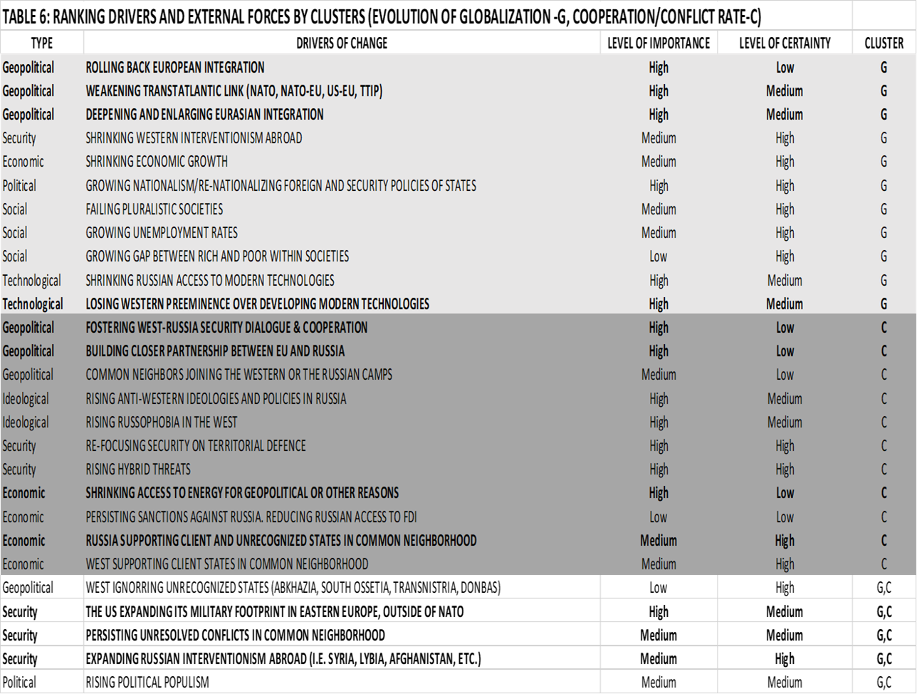

Slide 8
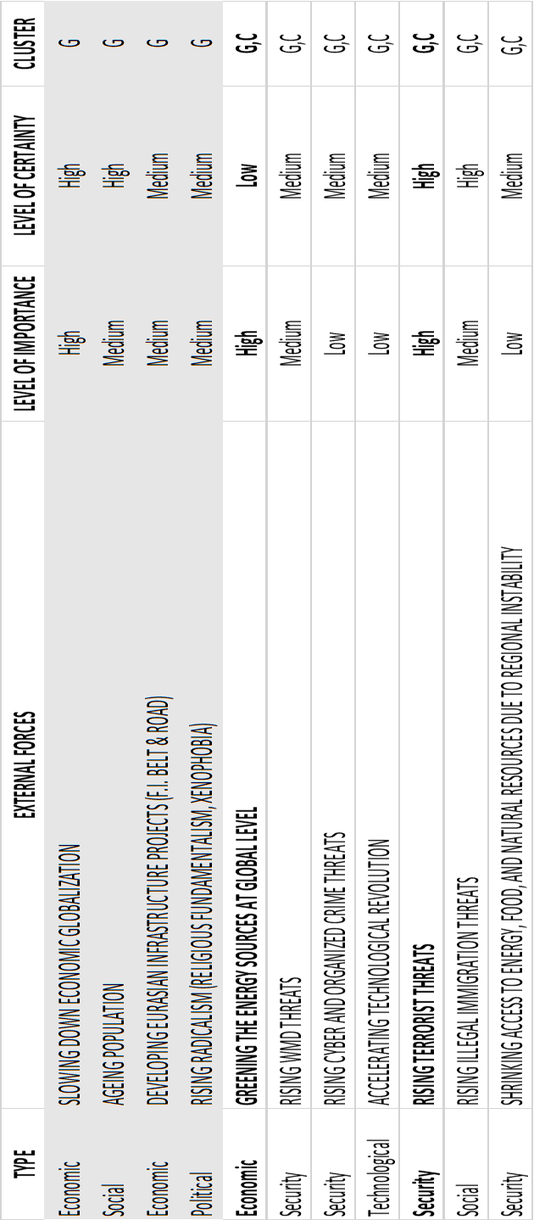

Slide 9
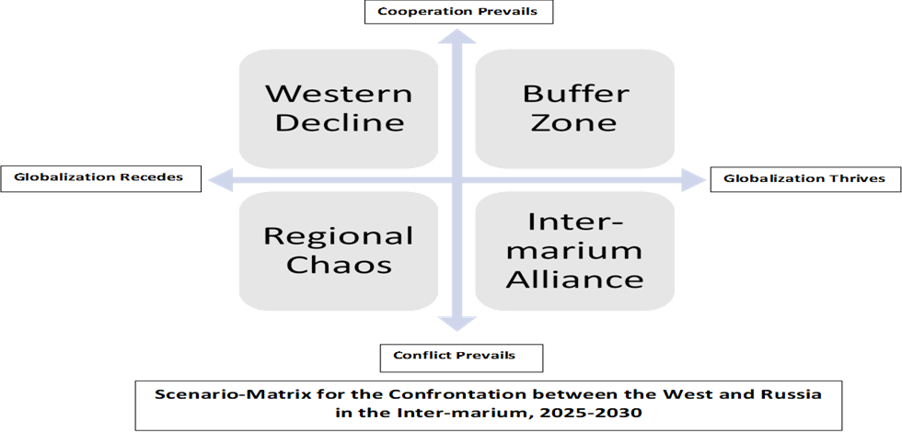

Slide 10
Conclusions and Recommendations
  EU dialogue with Russia needs to be restored in case three of the four envisaged scenarios would likely prevail: Buffer Zone, Western Decline, and the Inter-marium alliance.
Buffer Zone:
  last year, I suggested the Buffer Zone scenario might best fit with the current interests and capabilities of the EU; however, in this case, the EU would need to acknowledge Russian revisionist claims against the post-Cold War European security order to facilitate a pan-European public and institutional dialogue on the necessity and possible content of a new agreement on regional power sharing, that would cooperatively shape and regulate the current security environment, i.e. a “new deal” on European security.
  The scope of the dialogue: drivers of change largely depending on the cooperation/conflict rate (marked C in the table), drivers of change largely depending on both globalization and cooperation/conflict rate (marked G, and G,C, respectively, in the table), as well as on the whole range of external forces.
  Structural changes in US policy against Russia -implying a competitive/conflictual approach against Russia- require revisiting the implications for the future of Trans-Atlantic relations of EU’s potential choice of the buffer-zone scenario.
  The EU should consider with maximum caution and responsibility contemplating a “new deal” on European security with a revisionist Russia, bearing in mind the emerging East-West divide stemming from divergent security threat perceptions.

Slide 11

Conclusions and Recommendations
Western Decline
  A weakened NATO and EU ready to undertake, on the medium and longer term, a much bolder role in European security. Russia more daring to undertake geopolitical and hybrid (though not necessarily military) incursions in NATO and EU territory.
  Deepening divisions among the newer and older EU members might lead, at best, to a breakdown of the European integration, as we know it today, and, at worst, to renewed European geopolitical maps.
  Western decline scenario might result in growing cooperation between Russia and Western Europe, irrespective of US concerns with Russian intentions, as a weakening Europe would have no interest whatsoever to spend precious resources on picking geopolitical fights in its Eastern neighbourhood against Russia.
  In case the Western Decline seemed to prevail, the focus of the EU-Russia dialogue should move away from geopolitical and security drivers of change and external forces -which might potentially lead to regional chaos-, towards political, social, economic, and technological drivers and forces, which could help globalization to thrive, while creating conditions for a return to the buffer zone scenario.

Slide 12
Conclusions and Recommendations
Inter-Marium Alliance
  A possible follow-up to the Western Decline, this scenario was promoted by George Friedman (STRATFOR’s Executive Director) who argued for an Inter-marium alliance/confederation born from Eastern members of the European Union and current EU’s Eastern Partners joining together to retain their sovereignty in the face of Russian power, as a key element of an effective US strategy to contain an aggressive Russia, against the prospects of a dysfunctional NATO, and a disintegrating EU.
  In such a scenario, EU dialogue with Russia could serve as a guarantor of a managed confrontation between Russia and the West, against a potential collapse of Europe into the regional chaos scenario.
  In this situation, the focus of the EU-Russia dialogue should fall on selected drivers of change, such as: the rise of anti-Western ideologies and policies in Russia vs. the rise of Russo-phobia in the West, re-focusing security on territorial defence, hybrid threats, shrinking access to energy for geopolitical or other reasons in Europe, managing unresolved conflicts in the common neighbourhood, and the whole range of external forces, including responses to cyber, illegal immigration, and terrorist threats.

Slide 13
DISCUSSION

